Slide 1

What’s that Woof?
A Dog Breed Identification App

Slide 2
Relevance
Over 340 breeds recognized by Fédération Cynologique Internationale (FCI)
Many owners unaware of their pet’s breed
Can lead to lack of awareness against certain issues
Over 200 million stray dogs worldwide according to WHO
More than 4 million dogs enter animal shelters nationwide every year

Slide 3
Challenges and Solutions
Challenge: Lack of processing power/memory
Solution: Google Colaboratory
Solution: Using generators
Challenge: Android Development
Solution: Use precedent knowledge to make educated guesses
Solution: Online resources
Challenge: Time constraint
Solution: Task distribution, use of GitHub for efficient collective work
Challenge: Working with new technology
Solution:

Slide 4
Practicality
Current Uses
Animal shelter classification
Stray dog identification and care
Potential uses:
Lost dogs rescue
Dog (eventually pet) inventory

Slide 5
What we are proud of
Flexible, portable app design
Fluid, user-centric interface
Responsive UX
Aesthetic consistence
Achieved > 115x E(x) on last epoch (given E(x) = 0.0083)

Slide 6
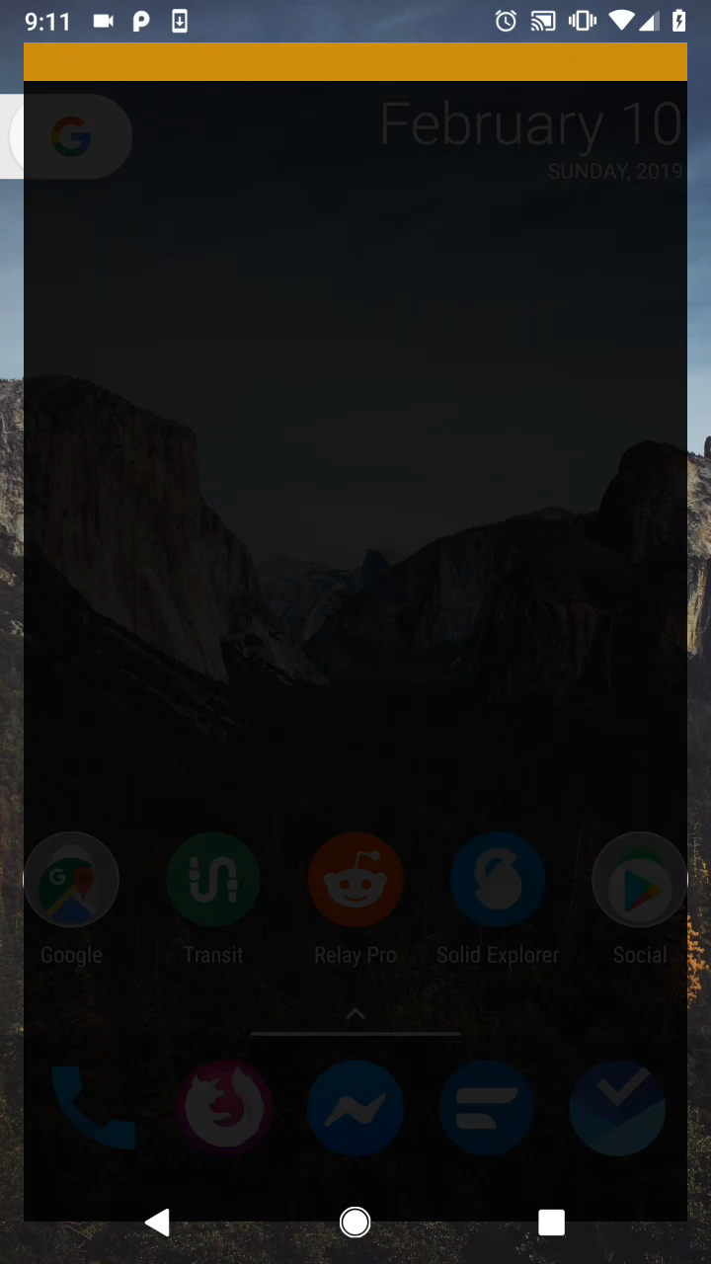

Demo!

Slide 7


